Slide 1
Tutorial 10 Group C10
5th November 2018
Joanne Ong

Slide 2
Plans for today
Problem 25.1
Problem 26.1
Problem 27.1
Problem 27.2
PE1 Questions
From last class
*May skip 27 today
*Pruning will not be tested in PE02

Slide 3
Problem 25.1
Suppose that we add a new restriction to the Tower of Hanoi puzzle. Let's say that the disks are on Peg A (or Peg 1) to begin with, and we are only allowed to move a disk either to Peg B from another peg or from Peg B to another peg.
*There was a bug for the description on the module site
Notes:
15 mins

Slide 4
Problem 25.1
How does the ”normal” tower of Hanoi work?

Slide 5
Notes:
Normal tower of hanoi. Wishful thinking!

Slide 6
Problem 25.1
void solve(long k, long source, long dest, long placeholder) {
if (k == 1) {
move(k, source, dest);
} else {
solve(k – 1, source, placeholder, dest);
move(k, source, dest);
solve(k – 1, placeholder, dest, source);
}
}
Notes:
You can see move as a kind of function for printing out the moves (abstraction of move)

Slide 7
Problem 25.1
Now: only allowed to move a disk either to Peg B from another peg or from Peg B to another peg.
Any ideas?
Try coding it out now! Test with smaller inputs (e.g. 2 to 4 disks) and check manually
Notes:
10 mins to code

Slide 8
Problem 25.1
void solve(long k, long source, long dest, long placeholder) {
if (k == 1) {
move(k, source, dest);
} else {
solve(k – 1, source, placeholder, dest);
move(k, source, dest);
solve(k – 1, placeholder, dest, source);
}
}
Notes:
What is the problem with the code here?

Slide 9
Problem 25.1
void solve(long k, long source, long dest, long placeholder) {
if (k == 1) {
move(k, source, dest); // Problem line
} else {
solve(k – 1, source, placeholder, dest);
move(k, source, dest); // Problem line
solve(k – 1, placeholder, dest, source);
}
}
Notes:
What is the problem with the code here?

Slide 10
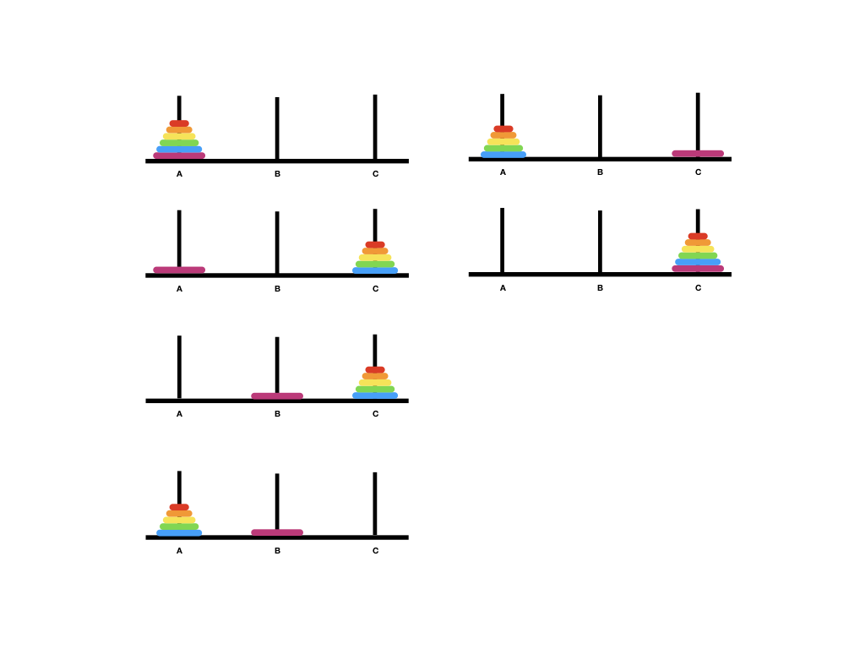

Slide 11
Problem 25.1
void solve(long k, long source, long dest, long placeholder) {
if (k == 1) {
move(k, source, placeholder);
move(k, placeholder, dest);
return;
} else {
solve(k – 1, source, dest, placeholder);
move(k, source, placeholder);
solve(k – 1, dest, source, placeholder);
move(k, placeholder, dest);
solve(k – 1, source, dest, placeholder);
}
}

Slide 12
Problem 25.1
What is the running time of this “new” algorithm?
solve(k – 1, source, dest, placeholder);
move(k, source, placeholder);
solve(k – 1, dest, source, placeholder);
move(k, placeholder, dest);
solve(k – 1, source, dest, placeholder);
Notes:
15 mins

Slide 13
Problem 25.1
What is the running time of this “new” algorithm?
solve(k – 1, source, dest, placeholder);
move(k, source, placeholder);
solve(k – 1, dest, source, placeholder);
move(k, placeholder, dest);
solve(k – 1, source, dest, placeholder);
T(k) = 3T(k – 1) + 2 = 9T(k – 2) + 6 + 2 … = O(3^{k})
Notes:
15 mins

Slide 14
Problem 26.1
To permute a string of length n:
Base case: only 1 character →1 permutation
By wishful thinking, assume we know how to permute strings of length n – 1.
Then, for each character in the string, we shift it to the first position, and solve for the remaining n – 1 characters.
Notes:
15 mins

Slide 15
Problem 26.1
permutate recursively
a
b
c
b
e
duplicate work if there are duplicate characters!
b
a
c
b
e
c
b
a
b
e
b
b
c
a
e
e
b
c
b
a
Notes:
But this would result in duplicate results if there are duplicate characters in the string!

Slide 16
Problem 26.1
Avoid generating duplicate permutations!
Notes:
15 mins

Slide 17
Problem 26.1
Try coding it now! (10 mins)
void permute(char a[], long len, long curr) {
// permute characters a[curr]..a[len-1] and print out a for each permutation.
if (curr == len-1) {
cs1010_println_string(a);
return;
}
permute(a, len, curr + 1);
for (long i = curr + 1; i < len; i += 1) {
if (...) { // Line A
swap(a, curr, i);
permute(a, len, curr + 1);
swap(a, i, curr);
}
}
}
Notes:
15 mins

Slide 18
Problem 26.1
permutate recursively
a
b
c
b
e
b
a
c
b
e
check before recurse:
has it appeared before?
if so, skip
c
b
a
b
e
a
b
c
b
e
e
b
c
a
a
Notes:
15 mins

Slide 19
Problem 26.1
bool appear_before(char a[], long k, long i) {
for (int j = k; j < i; j += 1) {
if (a[j] == a[i]) {
return true;
}
}
return false;
}
a[k]
a[i]
a
b
c
b
e
Notes:
15 mins

Slide 20
Problem 26.1
void permute(char a[], long len, long curr) {
if (curr == len-1) {
cs1010_println_string(a);
return;
}
permute(a, len, curr + 1);
for (long i = curr + 1; i < len; i += 1) {
if (!appear_before(a, curr, i) { // Line A
swap(a, curr, i);
permute(a, len, curr + 1);
swap(a, i, curr);
}
}
}
Notes:
15 mins

Slide 21
Problem 27.1 (may skip) nqueens
Given an n by n chessboard, find a possible placement of n queens so that the queens do not threaten each other.
Notes:
(5 mins)

Slide 22
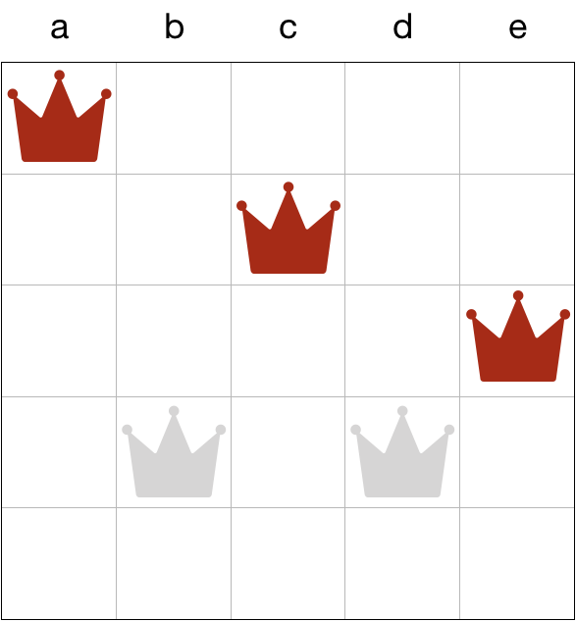
Problem 27.1 nqueens

Slide 23
Problem 27.1 nqueens
void nqueens(char queens[], long n, long row) {
if (row == n-1) {
if (!threaten_each_other_diagonally(queens, n)) {
cs1010_println_string(queens);
}
return;
}
if (!threaten_each_other_diagonally(queens, row)) {
nqueens(queens, n, row + 1);
}
for (long i = row + 1; i < n; i++) {
swap(queens, row, i);
if (!threaten_each_other_diagonally(queens, row)) {
nqueens(queens, n, row + 1);
}
swap(queens, row, i);
}
}

Slide 24
Problem 27.1 nqueens
bool threaten_each_other_diagonally(char queens[], long len) {
for (long i = 0; i < len; i += 1) {
if (has_a_queen_in_diagonal(queens, len, i)) {
return true;
}
}
return false;
}
Notes:
Has a queen in diagonal will check all the rows after the current row

Slide 25
Problem 27.1 nqueens
Identify the repetitive work being done in the calls threaten_each_other_diagonally.
Notes:
(5 mins)

Slide 26
Problem 27.1 nqueens
Here, we repeatedly check if the queens on row 0 to row (len – 1) threaten each other.
But when we recurse with nqueens(queens, n, row + 1), we already know that (!threaten_each_other_diagonally(queens, row)) is false (i.e. queens on rows 0 to (row – 1) )do not threaten each other

Slide 27
Already “safe.”
No need to check
again.
Only check the new
row against the queens
above.

Slide 28
Problem 27.1 nqueens
It is enough to check if the newly added queen threatens any of the queens in the previous rows!

Slide 29
Problem 27.2
void permute(char a[], long len, long curr) {
if (curr == len-1) {
cs1010_println_string(a);
return;
}
permute(a, len, curr + 1);
for (long i = curr + 1; i < len; i += 1) {
if (!appear_before(a, curr, i) { // Line A
swap(a, curr, i);
permute(a, len, curr + 1);
swap(a, i, curr);
}
}
}
Notes:
Previous solution to find permutations of a string

Slide 30
Problem 27.2
Restrict permutations to where the same character does not appear next to each other.

Slide 31
Problem 27.2
Idea: check if every ”first” character of a permutation is the same with the previous character.
If it is the same, just prune the process.

Slide 32
Problem 27.2
bool consecutive(const char a[], long curr, long i) {
return a[i] == a[curr-1];
}

Slide 33
Problem 27.2
void permute(char a[], long len, long curr) {
if (curr == len-1) {
if (!consecutive(a, curr, curr)) {
cs1010_println_string(a);
}
return;
}
if (!consecutive(a, curr, curr)) {
permute(a, len, curr+1); }
for (int i = curr+1; i < len; i++) {
if (!appear_before(a, curr, i) && !consecutive(a, curr, i)) {
swap(a, curr, i);
permute(a, len, curr+1);
swap(a, curr, i);
}
}
}

Slide 34
PE1 Newton
Try and solve the question now. (10 mins)
Notes:
15 mins

Slide 35
PE1 Newton
Common problems:
Did not check if x is already the root
Using the wrong type (should be using `double`)
Wrong terminating condition (should be fabs(f(a, b, c, d, x)) >= 0.000000001)

Slide 36
PE1 Newton
How can you make the solution design better and more efficient?
- Make finding f(x) and f’(x) functions
- Store f(x) in another variable instead of recomputing f(x) every time you need the result
Notes:
Not the marking criteria for PE01

Slide 37
PE1 Newton
double find_root(double a, double b, double c, double d, double x) {
while (fabs(f(a, b, c, d, x) >= 0.000000001) {
double fx = f(a, b, c, d, x);
double fpx = fp(a, b, c, d, x);
x -= fx/fpx;
}
return x;
}

Slide 38
PE1 Square
Try and solve the question now.
Notes:
15 mins

Slide 39
PE1 Square
What is your strategy?
Notes:
15 mins

Slide 40
PE1 Square
Assume that you know how to draw the smaller squares (wishful thinking).
Notes:
15 mins

Slide 41
PE1 Square
What are the base cases?
void print_square(double row, double width) {
if (…) {
} else if (…) {
} else if (…) {
} else {
}
}
Notes:
15 mins

Slide 42
PE1 Square
Case 1: When width is 1
void print_square(double row, double width) {
if (width == 1) {
} else if (…) {
} else if (…) {
} else {
}
}
Notes:
15 mins

Slide 43
PE1 Square
Case 1: When width is 1
void print_square(double row, double width) {
if (width == 1) {
cs1010_print_string(“#”);
} else if (…) {
} else if (…) {
} else {
}
}
Notes:
15 mins

Slide 44
PE1 Square
Case 2: When the row is a border row
void print_square(double row, double width) {
if (width == 1) {
cs1010_print_string(“#”);
} else if (row == 0 || row == width - 1) {
} else if (…) {
} else {
}
}
Notes:
15 mins

Slide 45
PE1 Square
Case 2: When the row is a border row
void print_square(double row, double width) {
if (width == 1) {
cs1010_print_string(“#”);
} else if (row == 0 || row == width - 1) {
print_line(width); // prints a line of ’#’ only
} else if (…) {
} else {
}
}
Notes:
15 mins

Slide 46
PE1 Square
Case 3: When the row is a spacing row
void print_square(double row, double width) {
if (width == 1) {
cs1010_print_string(“#”);
} else if (row == 0 || row == width - 1) {
print_line(width); // prints a line of ’#’ only
} else if (row == 1 || row == width - 2) {
} else {
}
}
Notes:
15 mins

Slide 47
PE1 Square
Case 3: When the row is a spacing row
void print_square(double row, double width) {
if (width == 1) {
cs1010_print_string(“#”);
} else if (row == 0 || row == width - 1) {
print_line(width); // prints a line of ’#’ only
} else if (row == 1 || row == width - 2) {
print_border(width); // prints a line of “ “ with first and last char “#”
} else {
}
}
Notes:
15 mins

Slide 48
PE1 Square
Case 4: Draw the square recursively
void print_square(double row, double width) {
if (width == 1) {
cs1010_print_string(“#”);
} else if (row == 0 || row == width - 1) {
print_line(width); // prints a line of ’#’ only
} else if (row == 1 || row == width - 2) {
print_border(width); // prints a line of “ “ with first and last char “#”
} else {
cs1010_print_string(”# ”);
print_square(row – 2, width – 4);
cs1010_print_string(“ #”);
}
}
Notes:
15 mins

Slide 49
PE1 Digits
Try and solve the question now.
Notes:
15 mins

Slide 50
PE1 Digits
Store the results and loop through the number while the number is > 0
long longest_count = -1;
long longest_digit;
long current_count = 0;
long current_digit = n % 10;
Notes:
15 mins

Slide 51
From last class Binary search variation
Task: Modify binary search (recursive version or otherwise) so it returns:
a position k such that a[k] <= q <= a[k + 1]
-1 if q is smaller than a[0]
n-1 if q is larger than a[n – 1]
(basically this is the position k that we can insert q to keep the array sorted)
Notes:
10 mins

Slide 52
From last class Binary search variation
/**
* Look for index which q can be inserted to maintain sorted list.
*
* @pre list is sorted
*/
long search(const long list[], long len, long q) {
long i = 0;
long j = len-1;
while (i <= j) {
long mid = (i+j)/2;
if (list[mid] == q) {
return mid;
} if (list[mid] > q) {
j = mid-1;
} else {
i = mid+1;
}
}
return i - 1; // change this line only
}

Slide 53
From last class Binary search variation
Why is this correct?
Invariant:
{ q > list[0]..list[i-1] and q < list[j+1]..list[n-1] }

Slide 54
From last class Binary search variation
Invariant:
{ q > list[0] .. list[i-1]
and q < list[j+1]..list[n-1] }
/**
* Look for index which q can be inserted to maintain sorted list.
*
* @pre list is sorted
*/
long search(const long list[], long len, long q) {
long i = 0;
long j = len-1;
while (i <= j) {
long mid = (i+j)/2;
if (list[mid] == q) {
return mid;
} if (list[mid] > q) {
j = mid-1;
} else {
i = mid+1;
}
}
return i - 1; // change this line only
}

Slide 55
From last class Binary search variation
Invariant:
{ q > list[0] .. list[i-1]
and q < list[j+1]..list[n-1] }
i
j
/**
* Look for q in list[i]..list[j].
*
* @pre list is sorted
* @pre q > list[0]..list[i-1] and q < list[j+1]..list[n-1]
*/

Slide 56
From last class Binary search variation
Invariant:
{ q > list[0] .. list[i-1]
and q < list[j+1]..list[n-1] }
long search(const long list[], long len, long q) {
long i = 0;
long j = len-1;
while (i <= j) {
long mid = (i+j)/2;
if (list[mid] == q) {
return mid;
} if (list[mid] > q) {
j = mid-1;
} else {
i = mid+1;
}
}
return i - 1; // change this line only
}

Slide 57
From last class Binary search variation
Invariant:
{ q > list[0] .. list[i-1]
and q < list[j+1]..list[n-1] }
i
mid
j
if (list[mid] == q) {
return mid;
}

Slide 58
From last class Binary search variation
Invariant:
{ q > list[0] .. list[i-1]
and q < list[j+1]..list[n-1] }
> q
i
mid
j
} else if (list[mid] > q) {
// { q > list[0]..list[i-1] and q < list[mid]..list[n-1] }
j = mid – 1;
}

Slide 59
From last class Binary search variation
Invariant:
{ q > list[0] .. list[i-1]
and q < list[j+1]..list[n-1] }
< q
mid
j
i
// { q is > list[0]..list[mid] and q < list[j]..list[n-1] }
i = mid + 1;

Slide 60
From last class Binary search variation
Invariant:
{ q > list[0]..list[i-1] and q < list[j+1]..list[n-1] }
Since this invariant is correct, then you can be sure that the final result is correct (i.e. the returned k is such that a[k] <= q <= a[k + 1])

